Slide 1
NFA, NFA To DFA and Regular Operations
CSE331 - Automate and Computability
BRAC University

Slide 2
Defining a NFA

Slide 3
Nondeterminism
Deterministic: When the machine is in a given state and reads the next input symbol, we know what the next state will be—it is determined; we call this deterministic computation.
Nondeterministic: In a nondeterministic machine, several choices may exist for the next state at any point.
Nondeterministic Finite Automata (NFA):
Nondeterministic Finite Automata is a Finite State Machine that accepts or rejects a string according to the pattern it defines.
Like a DFA, an NFA also consists of states and transitions. However, it has a lot less restrictions than a DFA.
An NFA can have more than one transition on one input symbol. It can be in more than one state at any given point.
In each step, whenever
there are two or more transitions, it "copies" itself and each copy follows a transition. If there is no possible transition, the copy “dies”.

Slide 4
NFA (Formal Definition)
Formal Definiton: An NFA is represented formally by a 5-tuple, (Q, Σ, δ, q0, F), consisting of:
● a finite set of states, Q.
● a finite set of input symbols, Σ .
● a transition function δ where δ: Q X Σ → P(Q) where P(Q) is the power set of Q.
● an initial (or start) state q0 ∈ Q
● a set of states F ⊆ Q

Slide 5
NFA (Accept/Final States)
Acceptance of a String by an NFA:
An NFA accepts the input string if there exists some choice of transitions that leads to the NFA ending in an accepting state.
Thus, one accepting branch is enough for the overall NFA to accept, but every branch must reject for the overall NFA to reject.

Slide 6
NFA (Example-1) - String ending with ‘abb’
L = {w | w ∈ (a, b)* and w ends with the substring abb}

Slide 7
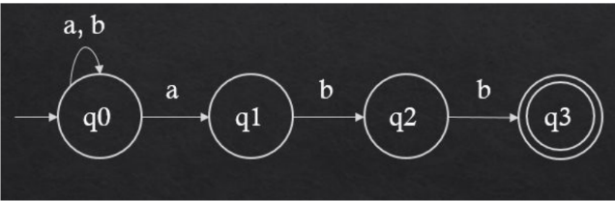
NFA (Example-1) - String ending with ‘abb’ [Solution]

Slide 8
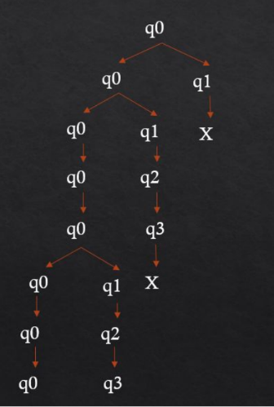
NFA (Example-1) - String ending with ‘abb’ [Simulation]
Let’s take a string aabbabb and simulate the NFA for the string.
a
a
b
b
a
b
The last states the NFA is in after the processing of the string is done are q0 and q3.
Since it contains the final state q3, the string aabbabb is accepted in the language.
b

Slide 9
NFA (Example-1) - String ending with ‘abb’ [State Transition Table]
States | a | b
q0 | {q0, q1} | {q0}
q1 | Φ | {q2}
q2 | Φ | {q3}
q3 | Φ | Φ
N.B: Here, the symbol, Φ (null), denotes an empty state i.e. there are not valid transitions.

Slide 10
NFA Variation

Slide 11
Epsilon NFA (ε-NFA)
Epsilon NFA:
The class of NFAs can be extended by allowing spontaneous transitions without reading any input symbols.
In the diagram, such transitions are represented by an edge labeled by epsilon (ε).
It is important to note that, ε is not considered as an input symbol. In fact, it is assumed that ε does not belong to any input alphabet.
An NFA with epsilon transition(s) is called ε-NFA.
Both NFAs and ε-NFAs recognize the same class of languages that are defined as Regular Languages. However, allowing transitions on epsilon adds certain programming conveniences.

Slide 12
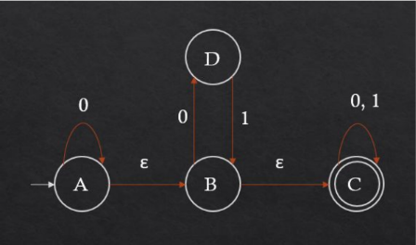
Epsilon NFA (Example Simulation)
Consider the following ε-NFA.

Slide 13
Epsilon NFA (Example Simulation)
When the automaton is at state A, it “copies” itself. One of the copies remain at A and the other one goes to B following the epsilon(ε) transition from A to B.
Again, when the automaton is at state B, it “copies” itself. One of the copies remain at B and the other one goes to C following the epsilon(ε) transition from B to C.
Basically, When the automaton is at state A, after completing the epsilon transitions, the states that the automaton is at are: A, B, C. This is called the epsilon(ε) closure.
ε-Closure of A is the set {A, B, C} and the ε-Closure of B is the set {B, C}.

Slide 14
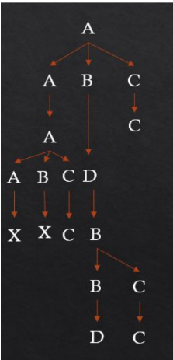
Epsilon NFA (Processing a String)
If we process the string 010 can be represented by the following diagram:

Slide 15
Comparison between DFA and NFA/ε-NFA
Epsilon NFA:
A DFA cannot be in more than one state at any given point but an NFA/ε-NFA can.
DFA does not allow moving to two or more different states, from the same state, on the same input symbol but an NFA/ε-NFA does.
In DFA, the transition function is δ : Q × ∑ → Q; In NFA/ε-NFA, the transition function is δ : Q × ∑ → P(Q); Here, P(Q) is the power set of Q.
Determinism does not allow epsilon transitions but nondeterminism does.

Slide 16
Conversion of NFA/ε-NFA to DFA

Slide 17
Formal Definition
Equivalence of Regular Languages
If L is a regular language, we can express L by a nondeterministic finite automata NFA or ε-NFA N, we can also represent it with the help of a deterministic finite automata DFA D.
Now the language of this NFA N is L(N) and the language of this DFA D is L(D).
Both the finite automata are created from same language, hence
  L(N) = L(D) = L
So, for the NFA N and the DFA D, there must be a mechanism to convert the N to D.
Why the conversion?
Consider simulating a string such as ‘aba’.
DFA is a faster recognizer!

Slide 18
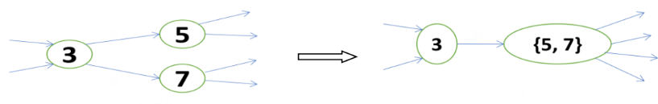
Prerequisites and Basic Terminologies
Approach
Each state in the DFA will correspond to a set of states of NFA. This approach is called subset-construction.

Slide 19
Prerequisites and Basic Terminologies (contd…)
Worst-case:
If there are 3 states in an NFA- A, B and C. If set of states are to be considered, 7 different sub-sets can be created (A, B, C, AB, BC, AC, ABC), thus creating 7 different possible states in DFA.
Here, for, number of states = 3, number of possible of states in DFA is 7≈2^3.
Now, if the number of states = 100, ≈2^100 different states will be created which is a huge number.
The above worst case scenario is very rare. In most of the cases, number of states decreases and makes DFA a faster recognizer.

Slide 20
Prerequisites and Basic Terminologies (contd…)
Input:
A NFA
S = States = { s0, s1,..., sN} = S_NFA
δ = Move/Transition function = Move_NFA
Move(S, a) → Set of states
Output:
A DFA
S = States = { ?, ?, ..., ?} = S_DFA
δ = Move function = Move_DFA
Move(s, a) → Single state from S_DFA

Slide 21
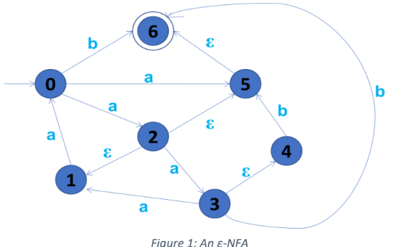
Prerequisites and Basic Terminologies
ε-Closure:
ε-Closure(s) is the set of states reachable from s on ε-transitions.
ε-closure (2) = { 2, 1, 5, 6 }
ε-Closure (S) = { t | t ∈ ε-closure(s) for all s ∈ S }
For example, from Figure 1,
ε-closure ({2, 3}) = { 1, 2, 3, 4, 5, 6 }

Slide 22
Prerequisites and Basic Terminologies (contd…)
Move Functions:
Deterministic Machine:
  Move_DFA(s, ch) → t
Non-deterministic Machine:
  Move_NFA(S, ch) → T
  If s ∈ S and there is an edge t, then t ∈ T
  For example, from Figure 1,
  Move_NFA(0, a) = {2, 5}
  Move_NFA({0, 3}, a) = {1, 2, 5}

Slide 23
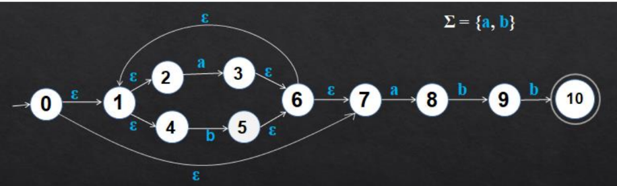
Conversion from NFA to DFA (Example)
Consider the following ε-NFA.

Slide 24
Conversion from NFA to DFA (Example) (contd…)
Start State:
ε-Closure (0)
= { 0, 1, 2, 4, 7 }
= A

Slide 25
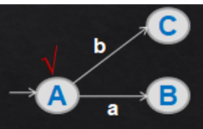
Conversion from NFA to DFA (Example) (contd…)
A = { 0, 1, 2, 4, 7 } (Unmarked)
Move_DFA (A, a)
= ε-Closure (Move_NFA (A, a))
= ε-Closure ({3, 8})
= {1, 2, 3, 4, 6, 7, 8}
= B (Unmarked)
Move_DFA (A, b)
= ε-Closure (Move_NFA (A, b))
= ε-Closure ({5})
= {1, 2, 4, 5, 6, 7}
= C (Unmarked)
Mark(A)

Slide 26
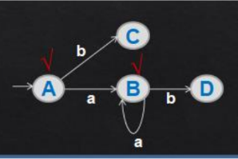
Conversion from NFA to DFA (Example) (contd…)
B = {1, 2, 3, 4, 6, 7, 8} (Unmarked)
Move_DFA (B, a)
= ε-Closure (Move_NFA (B, a))
= ε-Closure ({3, 8})
= {1, 2, 3, 4, 6, 7, 8}
= B
Move_DFA (B, b)
= ε-Closure (Move_NFA (B, b))
= ε-Closure ({5, 9})
= {1, 2, 4, 5, 6, 7, 9}
= D (Unmarked)
Mark(B)

Slide 27
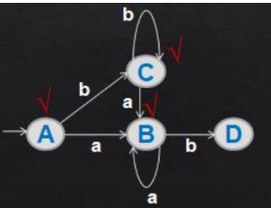
Conversion from NFA to DFA (Example) (contd…)
C = {1, 2, 4, 5, 6, 7} (Unmarked)
Move_DFA (C, a)
= ε-Closure (Move_NFA (C, a))
= ε-Closure ({3, 8})
= {1, 2, 3, 4, 6, 7, 8}
= B
Move_DFA (C, b)
= ε-Closure (Move_NFA (C, b))
= ε-Closure ({5})
= {1, 2, 4, 5, 6, 7}
= C
Mark(C)

Slide 28
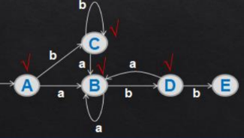
Conversion from NFA to DFA (Example) (contd…)
D = {1, 2, 4, 5, 6, 7, 9} (Unmarked)
Move_DFA (D, a)
= ε-Closure (Move_NFA (D, a))
= ε-Closure ({3, 8})
= {1, 2, 3, 4, 6, 7, 8}
= B
Move_DFA (D, b)
= ε-Closure (Move_NFA (D, b))
= ε-Closure ({5, 10})
= {1, 2, 4, 5, 6, 7, 10}
= E (Unmarked)
Mark(D)

Slide 29
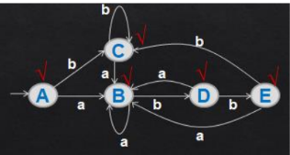
Conversion from NFA to DFA (Example) (contd…)
E = { 1, 2, 4, 5, 6, 7, 10} (Unmarked)
Move_DFA (E, a)
= ε-Closure (Move_NFA (E, a))
= ε-Closure ({3, 8})
= {1, 2, 3, 4, 6, 7, 8}
= B
Move_DFA (E, b)
= ε-Closure (Move_NFA (E, b))
= ε-Closure ({5})
= {1, 2, 4, 5, 6, 7}
= C
Mark(E)

Slide 30
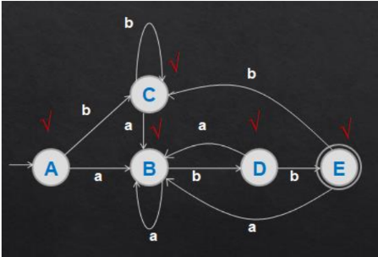
Conversion from NFA to DFA (Example Solution)
Since, E contains the final state of the NFA (state 10), the final state of the DFA should be E. The final DFA is given below:

Slide 31
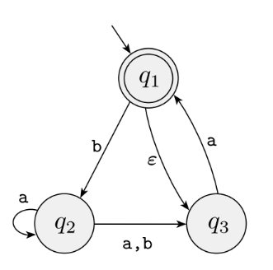
Conversion from NFA to DFA (Practice)
Convert the following NFA to DFA following the subset construction method shown

Slide 32
Closure under the
Regular Operations

Slide 33
Closure under Union Operation (NFA)
Theorem:
The class of regular languages is closed under the union operation.
Proof Idea:
We have regular languages A1 and A2 and want to prove that A1 ∪ A2 is regular.
The idea is to take two NFAs, N1 and N2 for A1 and A2, and combine them into one new NFA, N.
Machine N must accept its input if either N1 or N2 accepts this input.

Slide 34
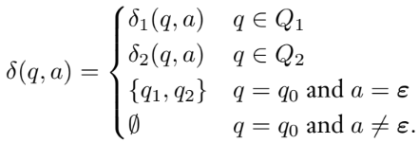
Closure under Union Operation (NFA) [Formal]
Proof
Let N1 = (Q1, Σ, δ1, q1, F1) recognize A1, and
N2 = (Q2, Σ, δ2, q2, F2) recognize A2.
Construct N = (Q, Σ, δ, q0, F) to recognize A1 ∪ A2.
  Q = {q0} ∪ Q1 ∪ Q2. The states of N are all the states of N1 and N2, with the addition of a new start state q0.
  The state q0 is the start state of N.
  The set of accept states F = F1 ∪ F2. The accept states of N are all the accept states of N1 and N2. That way, N accepts if either N1 accepts OR N2 accepts.
  Define δ so that for any q ∈ Q and any a ∈ Σε:

Slide 35
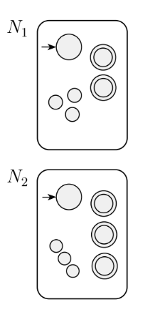
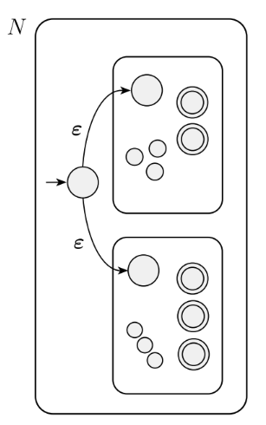
Closure under Union Operation (NFA) [State Diagram]

Slide 36
Closure under Concatenation Operation (NFA)
Theorem:
The class of regular languages is closed under the concatenation operation.
Proof Idea:
We have regular languages A1 and A2 and want to prove that A1 ◦ A2 is regular.
The idea is to take two NFAs, N1 and N2 for A1 and A2, and combine them into one new NFA, N.
Machine N must accept its input if N2 accepts this input.

Slide 37
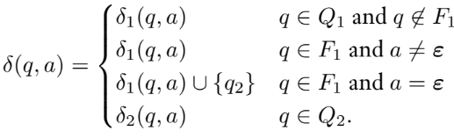
Closure under Concatenation Operation (NFA) [Formal]
Proof
Let N1 = (Q1, Σ, δ1, q1, F1) recognize A1, and
N2 = (Q2, Σ, δ2, q2, F2) recognize A2.
Construct N = (Q, Σ, δ, q0, F) to recognize A1 ◦ A2..
  Q = Q1 ∪ Q2. The states of N are all the states of N1 and N2.
  The state q0 is the same as the start state of N1 i.e q1.
  The accept states F are the same as the accept states of N2, i.e. F2.
  Define δ so that for any q ∈ Q and any a ∈ Σε:

Slide 38
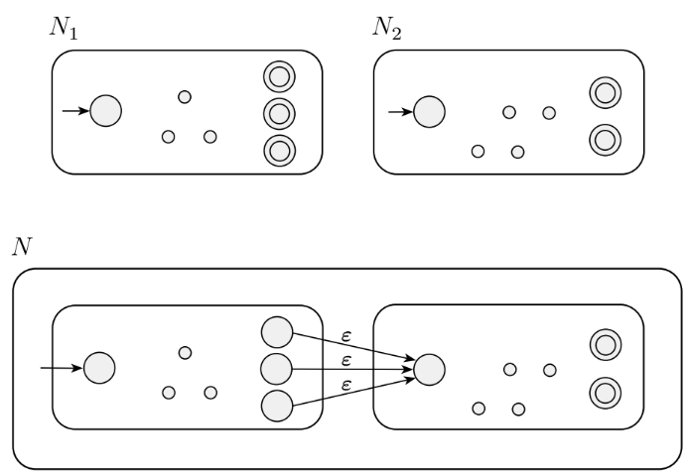
Closure under Concatenation Operation (NFA) [State Diagram]

Slide 39
Closure under Star Operation (NFA)
Theorem:
The class of regular languages is closed under the star operation.
Proof Idea:
We have regular languages A1 and want to prove that A1∗ is regular.
The idea is to take an NFA N1 for A1 and modify it to recognize A∗ to form NFA N.
Machine N must accept its input whenever it can be broken into several pieces and N1 accepts each piece.

Slide 40
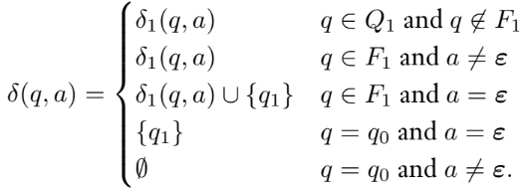
Closure under Star Operation (NFA) [Formal]
Proof
Let N1 = (Q1, Σ, δ1, q1, F1) recognize A1.
Construct N = (Q, Σ, δ, q0, F) to recognize A1∗.
  Q = {q0} ∪ Q1. The states of N are the states of N1 plus a new start state.
  The state q0 is the start state of N.
  F = {q0} ∪ F1. The accept states are the old accept states plus the new start state.
  Define δ so that for any q ∈ Q and any a ∈ Σε:

Slide 41
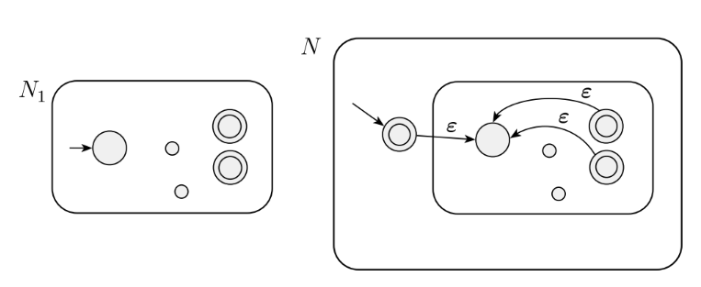
Closure under Star Operation (NFA) [State Diagram]

